Slide 1
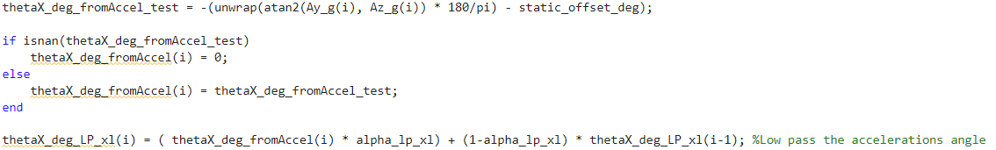


This is the complete equation for a complementary filter. No other math is required. This IS the high and low pass filter, there is no need to apply additional filters:
$θ_{t}=α×\left(θ_{t−1}+ω_{t}dt\right)+\left(1−α\right)\left(\operatorname{atan}{\frac{a_{t, lat}}{a_{t,vert}}}\right)$
This is what your code does. You are repeatedly weighting the gyro data and acceleration data in different ways, rather than just once. It sort of works, but not in a predictable way:
“Low pass the acceleration angles”
Calculate roll with pure integration
“Apply acceleration complementary filter”
“Low pass the gyro data”
$θ_{t,LP,XL}=α_{LP,XL}×\operatorname{atan}{\frac{a_{t, lat}}{a_{t,vert}}}+\left(1−α_{LP,XL}\right)\left(θ_{t,LP,XL−1}\right)$
$$θ_{t,PI}=θ_{t−1,PI}+ω_{t}dt$$
$θ_{t,comp}=α×θ_{t,PI}+\left(1−α\right)\left(θ_{t,LP,XL}\right)$
By using the roll angle as calculated from cumulative pure integration, you are carrying forward all error due to integration of the gyro rate bias. This is why you get bad results with larger time constants. A small time constant lowers the weight of this term.
$θ_{t,LP}=α_{HP}×θ_{t,comp}+\left(1−α_{HP}\right)\left(θ_{t−1,LP}\right)$

Slide 2
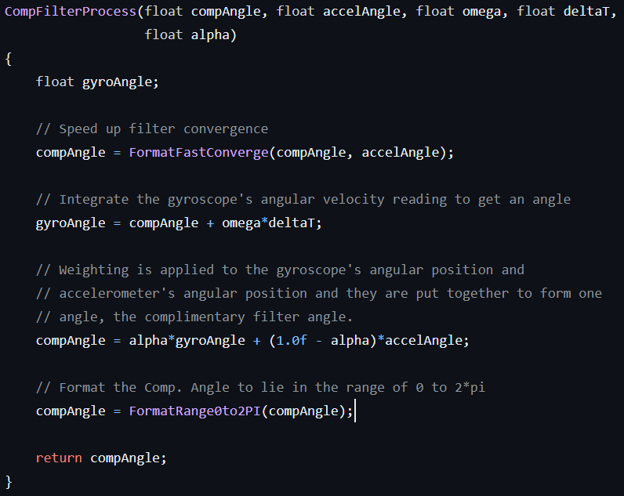
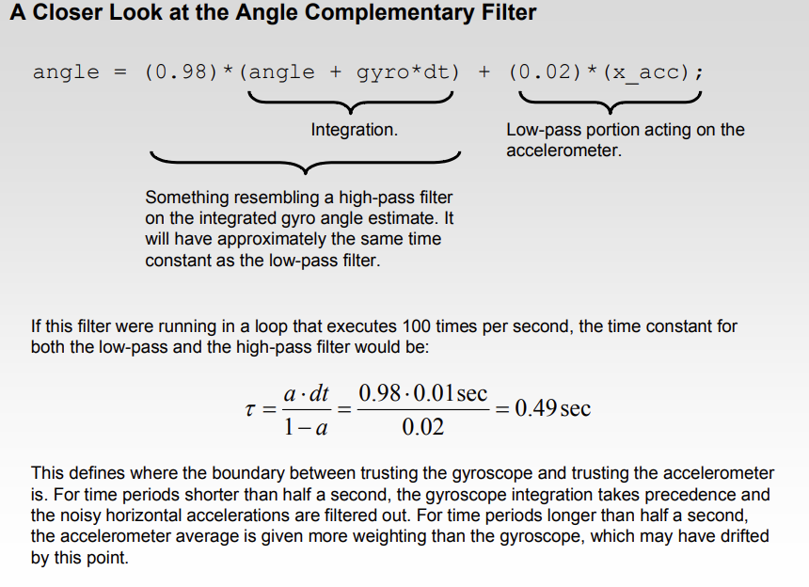

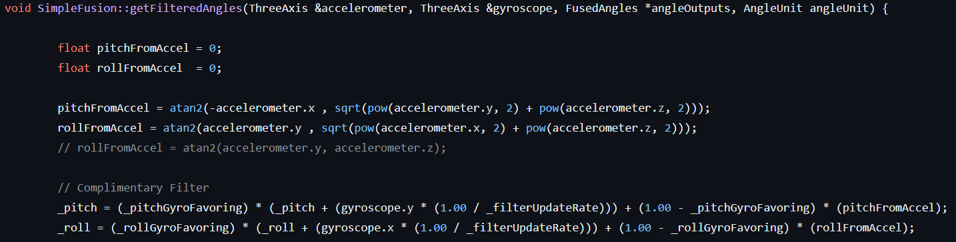
https://github.com/vishwas1101/Filters/blob/master/Complementary_Filter.ino
https://github.com/seanboe/SimpleFusion/blob/master/src/simpleFusion.cpp
https://github.com/UlrikHjort/complementary-filter-python/blob/master/ComplementaryFilter.py
https://github.com/robosam2003/complementary-filter/blob/main/src/complementary.txt
https://github.com/tcleg/Six_Axis_Complementary_Filter/blob/master/C/six_axis_comp_filter.c

